Slide 1


Check-in User Manual
Access the portal through https://bit.ly/TheNewDataO ps
Works best on a PC; limited functionality on mobile.

Slide 2


Click on Check in.

Slide 3
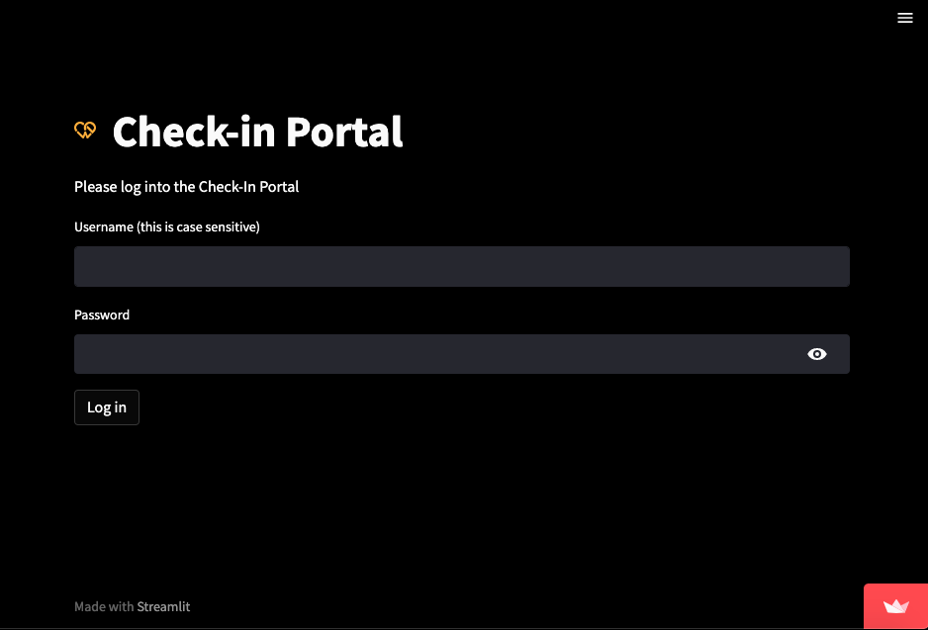
Insert Relevant Properties.
Username (this is case sensitive):
Password: **********

Slide 4
Check-in

Slide 5
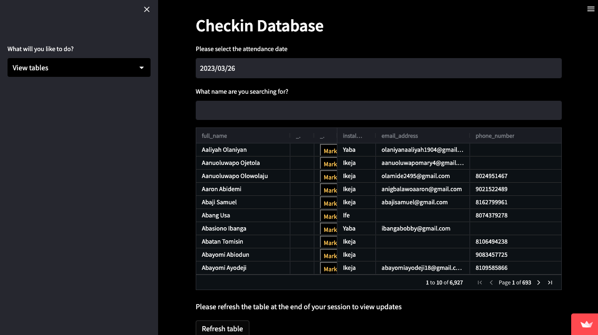
First, select a date that corresponds to a Sunday.
The table with church members data is loaded with a maximum of 10 people per page. You can see more people by clicking the arrow symbols on the table. Comment column is editable for comments; phone number and email address columns are editable for updates
Second, click on the yellow mark button to mark team members as either present or absent.
Entries are automatically saved, however, click on refresh table after your session to view your updates.
Sidebar Options:
View tables
date
refresh
pages

Slide 6
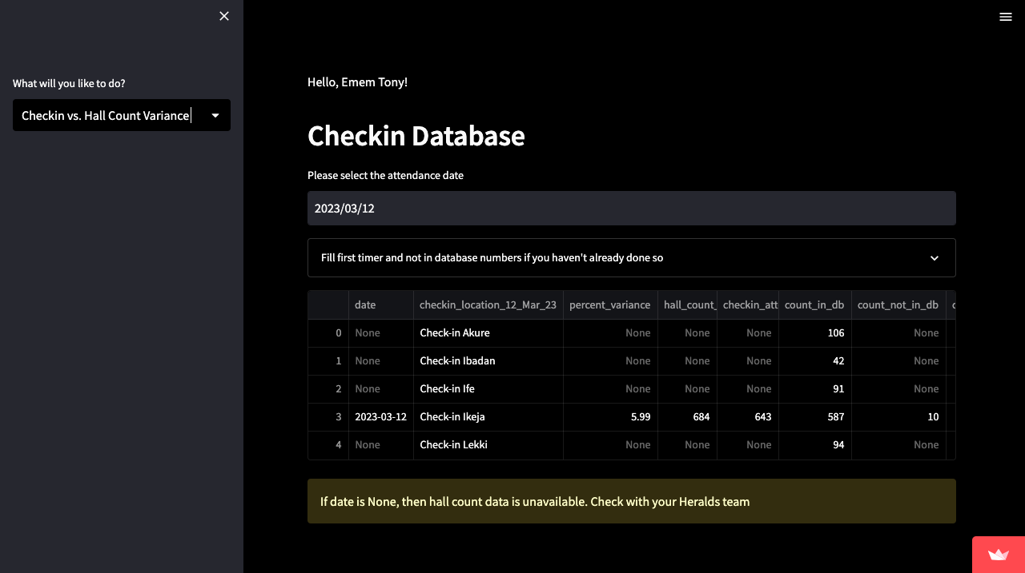
Sidebar Options:
Check-in vs. Hall Count Variance
Please input the number of first timers and members not on database in the expander.
The following table will show you the percentage difference between hall count and check-in count.
Percentage difference between hall count and check-in

Slide 7
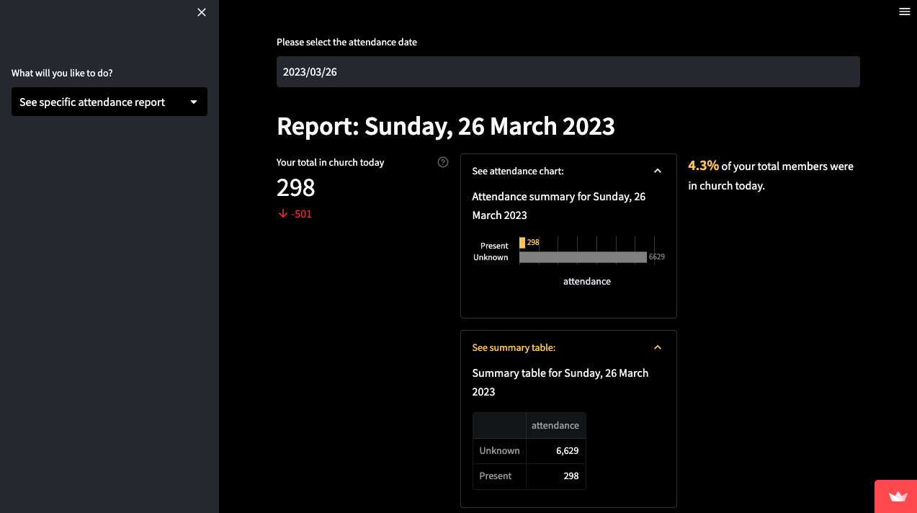

First, select a date that corresponds to a Sunday.
On the left, your total members in church for the selected Sunday, with a comparison to last week directly underneath (green arrow is an increase; red is a decrease), is shown.
In the middle, the attendance table and chart is shown in an expandable frame with
numbers present, absent and blank (unknown).
On the right, the percentage of attendees is shown. A congratulatory message is displayed if more than 70% of your team members are present.
Below is a summary paragraph of the statistics.
Sidebar Options:
Attendance report
(best viewed on PC)
Members in church
Expandable frames
Member attendance percentage

Slide 8
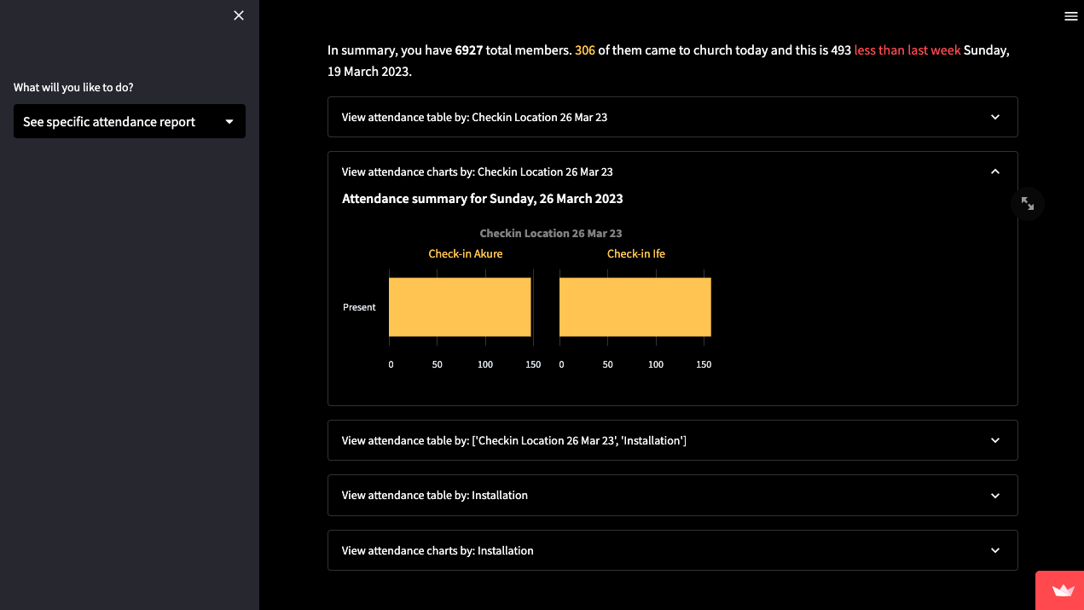
First, select a date that corresponds to a Sunday.
Sidebar Options:
Attendance report
(best viewed on PC)
Below is a summary paragraph.
There are also expandable frames that shows you attendance per Check-in location either as tables or charts.

Slide 9
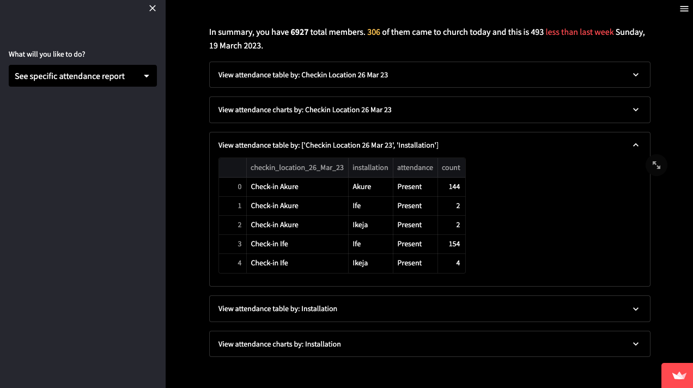
First, select a date that corresponds to a Sunday.
Sidebar Options:
Attendance report
(best viewed on PC)
Below is a summary paragraph.
There are also expandable frames that shows you attendance per Check-in location & installation on a table.

Slide 10
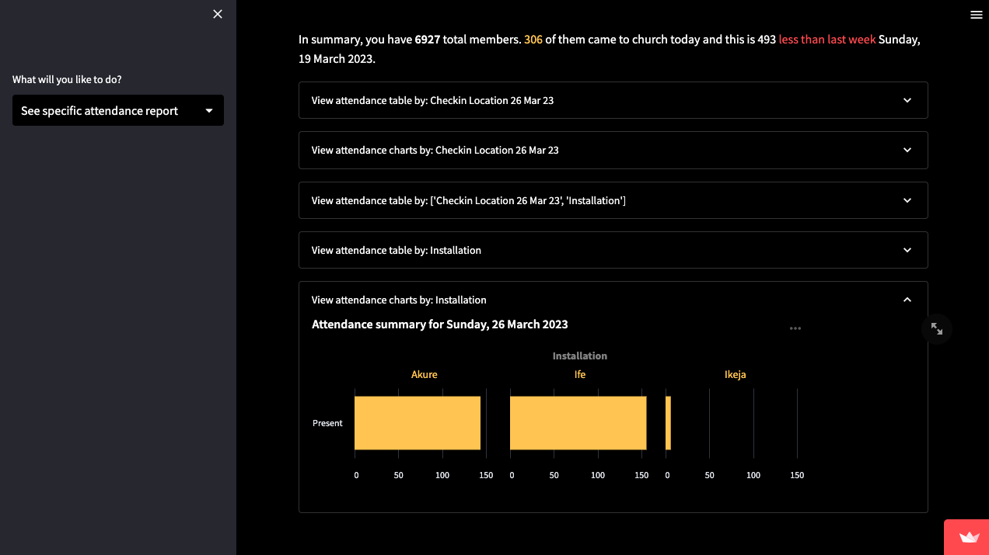
First, select a date that corresponds to a Sunday.
Sidebar Options:
Attendance report
(best viewed on PC)
Below is a summary paragraph.
There are also expandable frames that shows you attendance per installation either as tables or charts.

Slide 11
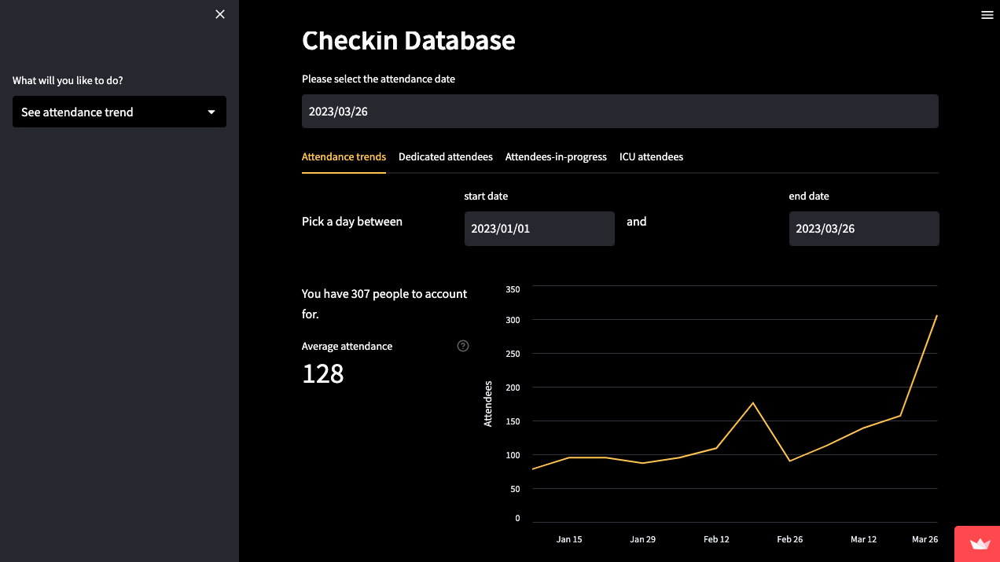
First, select a date that corresponds to a Sunday.
There are four tabs: attendance trends, dedicated team, team-in-progress and ICU team.
Attendance trends show the number of attendees in your installation over the selected period. On the left, the average attendance over that period is shown. There is also an expandable frame that shows attendance trends installation.
Dedicated team counts people in each service team with more than 70% attendance each.
Team-in-progress counts people in each service team with 50 to 70% attendance each.
ICU team counts people in each service team with less than 50% attendance each.
Please pay extra care and attention to your team in progress and ICU team.
Sidebar Options:
Attendance trends
(best viewed on PC)
Selected period
Average attendance over selected period

Slide 12
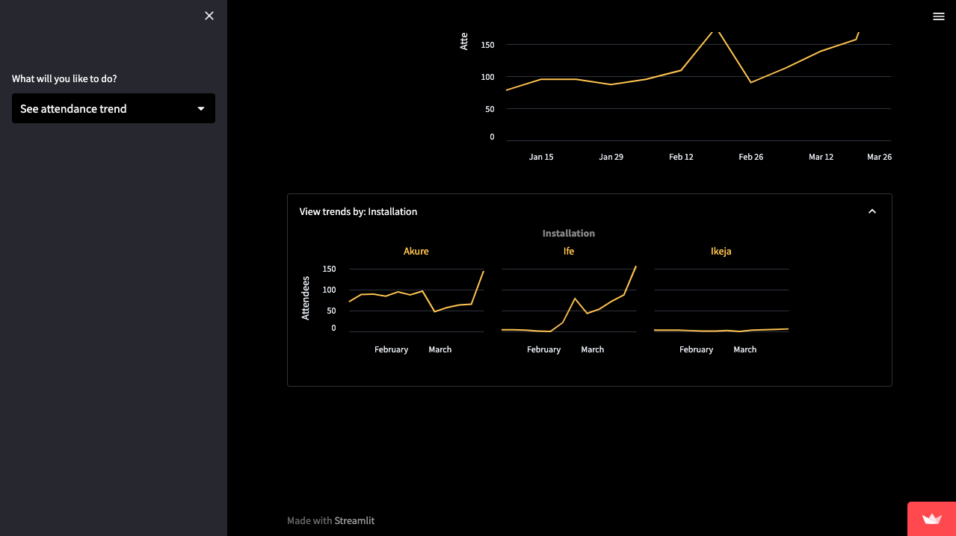
First, select a date that corresponds to a Sunday.
There are four tabs: attendance trends, dedicated team, team-in-progress and ICU team.
Attendance trends show the number of attendees in your installation over the selected period. On the left, the average attendance over that period is shown. There is also an expandable frame that shows attendance trends installation.
Dedicated team counts people in each service team with more than 70% attendance each.
Team-in-progress counts people in each service team with 50 to 70% attendance each.
ICU team counts people in each service team with less than 50% attendance each.
Please pay extra care and attention to your team in progress and ICU team.
Sidebar Options:
Attendance trends
(best viewed on PC)

Slide 13
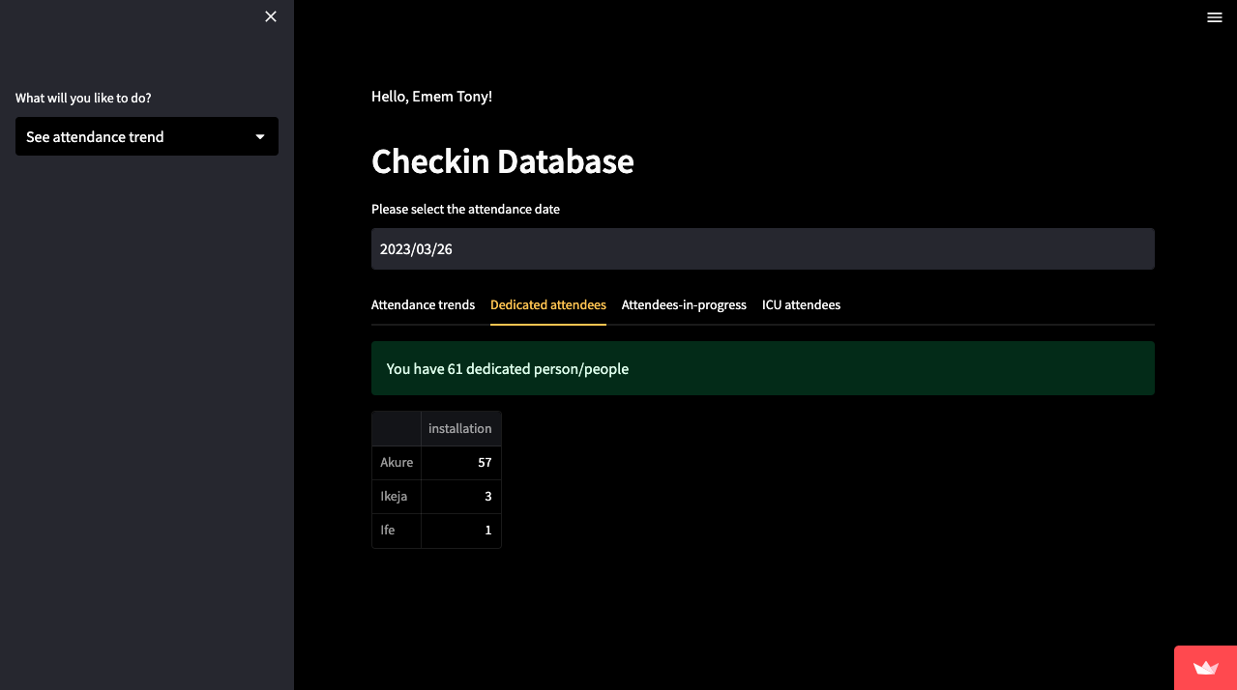
First, select a date that corresponds to a Sunday.
There are four tabs: attendance trends, dedicated team, team-in-progress and ICU team.
Attendance trends show the number of attendees in your installation over the selected period. On the left, the average attendance over that period is shown. There is also an expandable frame that shows attendance trends installation.
Dedicated team counts people in each service team with more than 70% attendance each.
Team-in-progress counts people in each service team with 50 to 70% attendance each.
ICU team counts people in each service team with less than 50% attendance each.
Please pay extra care and attention to your team in progress and ICU team.
Sidebar Options:
Attendance trends
(best viewed on PC)

Slide 14
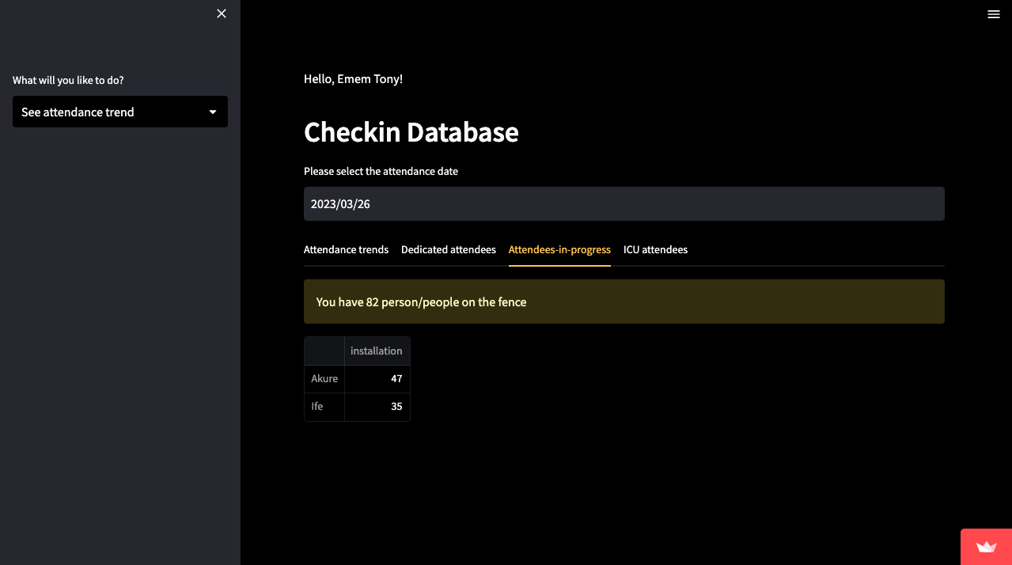
First, select a date that corresponds to a Sunday.
There are four tabs: attendance trends, dedicated team, team-in-progress and ICU team.
Attendance trends show the number of attendees in your installation over the selected period. On the left, the average attendance over that period is shown. There is also an expandable frame that shows attendance trends installation.
Dedicated team counts people in each service team with more than 70% attendance each.
Team-in-progress counts people in each service team with 50 to 70% attendance each.
ICU team counts people in each service team with less than 50% attendance each.
Please pay extra care and attention to your team in progress and ICU team.
Sidebar Options:
Attendance trends
(best viewed on PC)

Slide 15
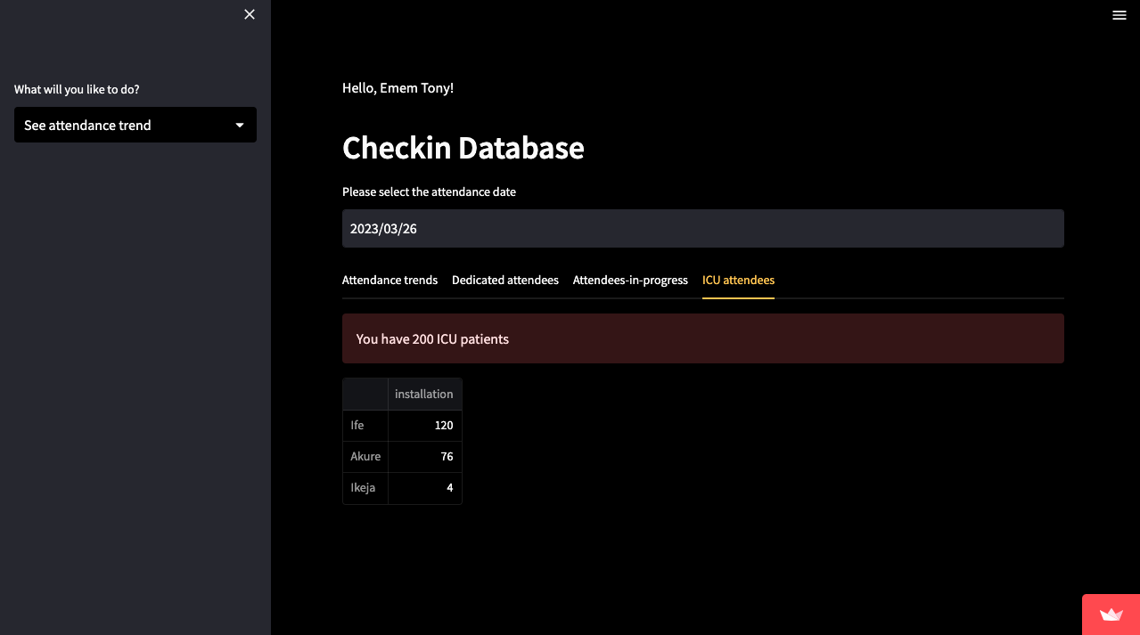
First, select a date that corresponds to a Sunday.
There are four tabs: attendance trends, dedicated team, team-in-progress and ICU team.
Attendance trends show the number of attendees in your installation over the selected period. On the left, the average attendance over that period is shown. There is also an expandable frame that shows attendance trends installation.
Dedicated team counts people in each service team with more than 70% attendance each.
Team-in-progress counts people in each service team with 50 to 70% attendance each.
ICU team counts people in each service team with less than 50% attendance each.
Please pay extra care and attention to your team in progress and ICU team.
Sidebar Options:
Attendance trends
(best viewed on PC)

